Slide 1

Robotic Processing Automation Solution
Automatic Email Generation

Slide 2
Purpose of RPA Solution
This RPA solution aims to automatically generate & send defined emails through Google Chrome & gmail to defined recipients.
Launch Gmail through google chrome
Choose account & sign in
Compose new email
Enter subjects & recipients
Terminate browser
Logout of account
Send email
Enter predefined email body & attachments

Slide 3
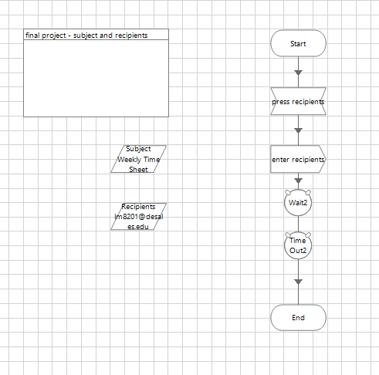
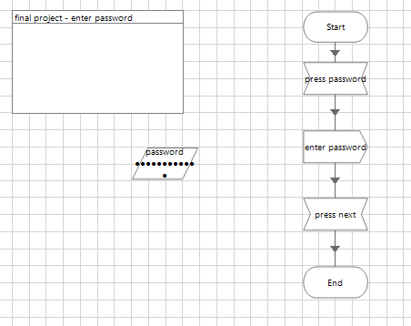
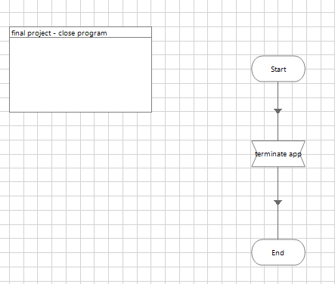
Object Studio
Launch
Choose account
Enter password
Compose new email
Subjects & recipients
Write email
Click send
Sign out
Close program

Slide 4
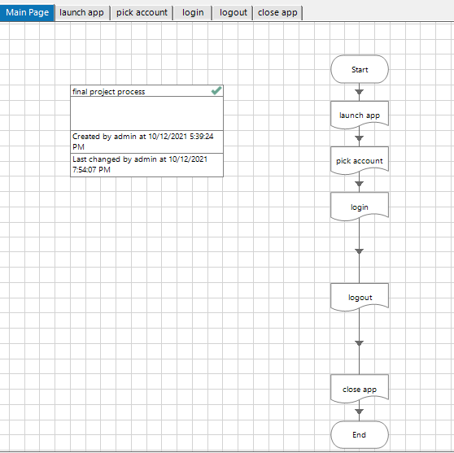
Business Process

Slide 5
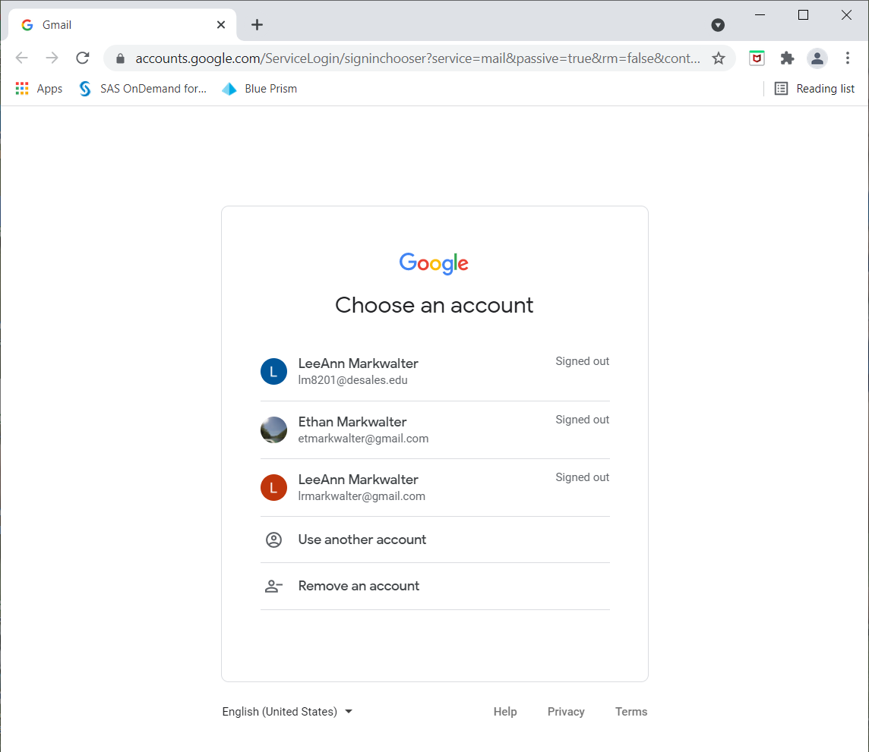
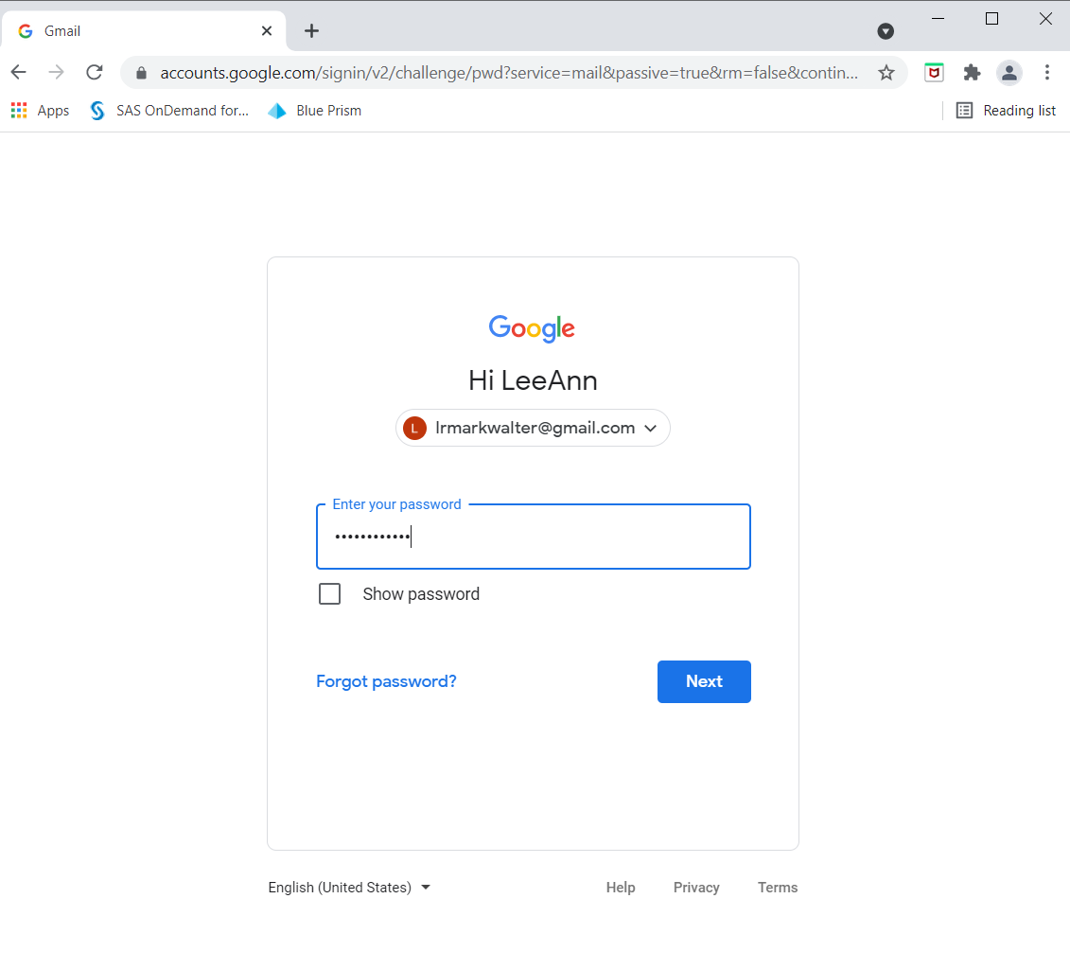
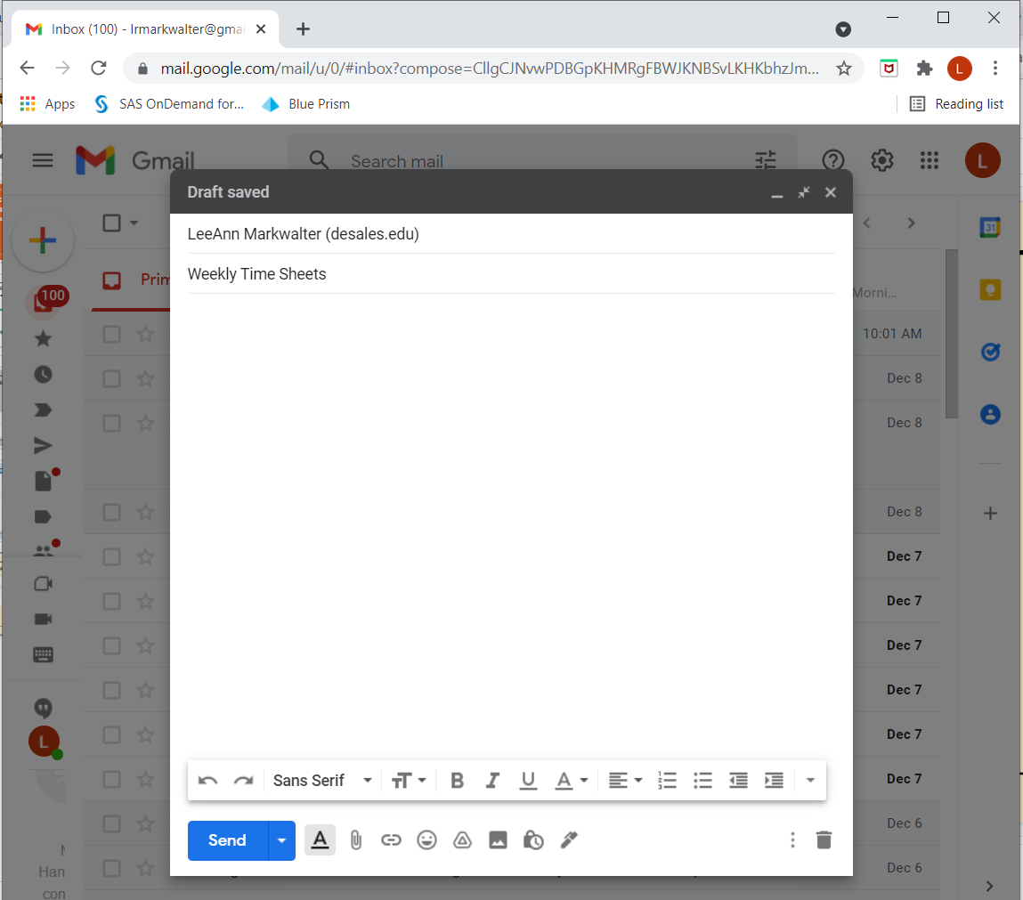
Solution in Action

